Slide 1
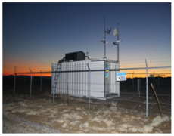
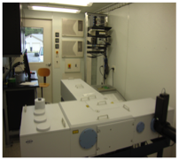
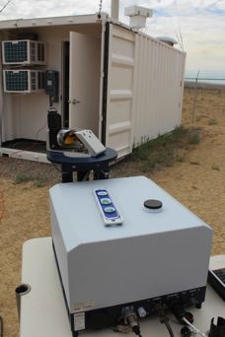
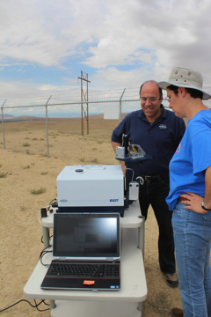

Off-the-shelf Commercial Compact Solar FTS for CO₂ and CH₄ Observations for MRV
M. K. Dubey¹, Z. Butterfield¹, R. Lindenmaier¹, H. Parker¹,
J. Hedelius², D. Wunch², P. Wennberg² and F. Hase³
¹Los Alamos National Laboratory, Los Alamos, NM,
²Caltech, Pasadena, CA and ³KIT, Karlsruhe, Germany
dubey@lanl.gov
.
TCCON
125HR
EM27/SUN
COCCON
NASA – CMS Project Report Bethesda, Maryland 13 Nov 2014
Notes:
Gas has been produced from coal and conventional mining of shallow oil and gas reservoirs in the 20th century. In the 21st century US is undergoing a transformation in oil and gas exploration by digging deeper into the gas rich shale to extract natural gas profitably to achieve energy independence. US natural gas production has increased dramatically to 23 trillion cubic feet/year in 2011 and is projected to grow to 33 trillion cubic feet/year in 2040. It has moderated the net CO2 emissions from the US that have dropped over the last few years since 2008.

Slide 2
Outline: Enable Off-the-Shelf Validation Technologies in the Developing World
Atmospheric verification of CH₄ and CO₂ fluxes from ground (TCCON) and space is feasible.
TCCON (high resolution solar FTS’s to ground truth satellites) has gaps in developing regions due to its large size, high costs and operational complexity.
Harness new compact commercial low resolution solar FTS that is inexpensive to fill gaps and open difference measurements of regional fluxes.
Compared performance of the compact FTS at power plant, urban and remote TCCON site.

Slide 3

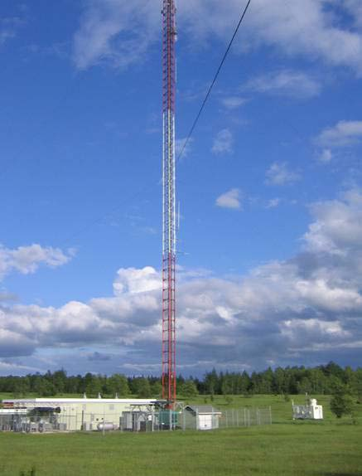

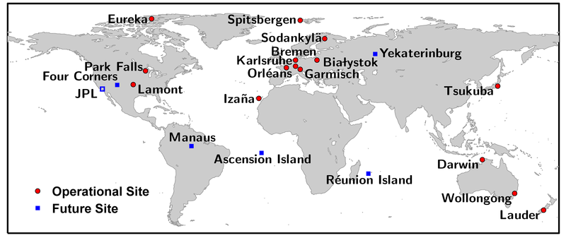
TCCON Valuable Science in Developed Nations with Gaps in Developing Regions
Constrain global carbon fluxes to improve carbon cycle models
Primary validation (ground-truth) dataset for satellite instruments
  GOSAT, OCO-2 and others
Methane emission verification over US
Can an off-the-shelf compact and robust instrument fill gaps without compromising accuracy and long term stability?
Park Falls, Wisconsin, USA
OCO-2
WLEF Tall Tower
TCCON Station

Slide 4
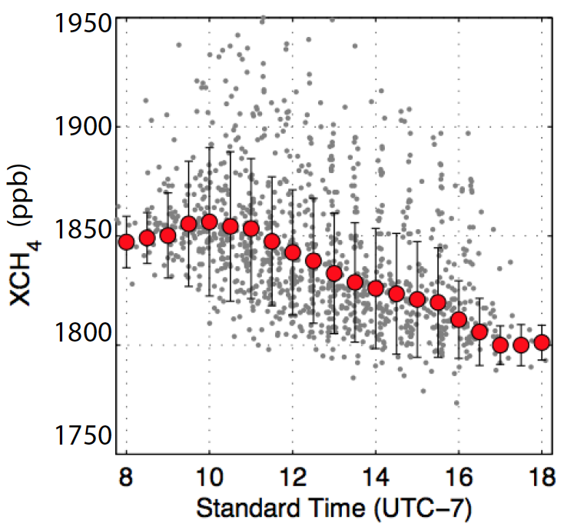
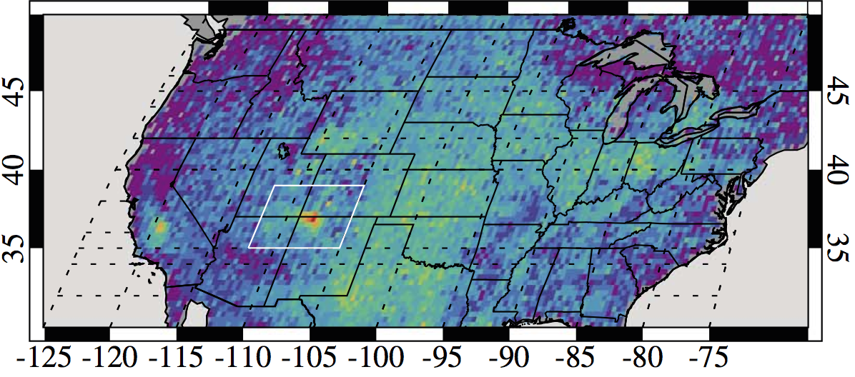
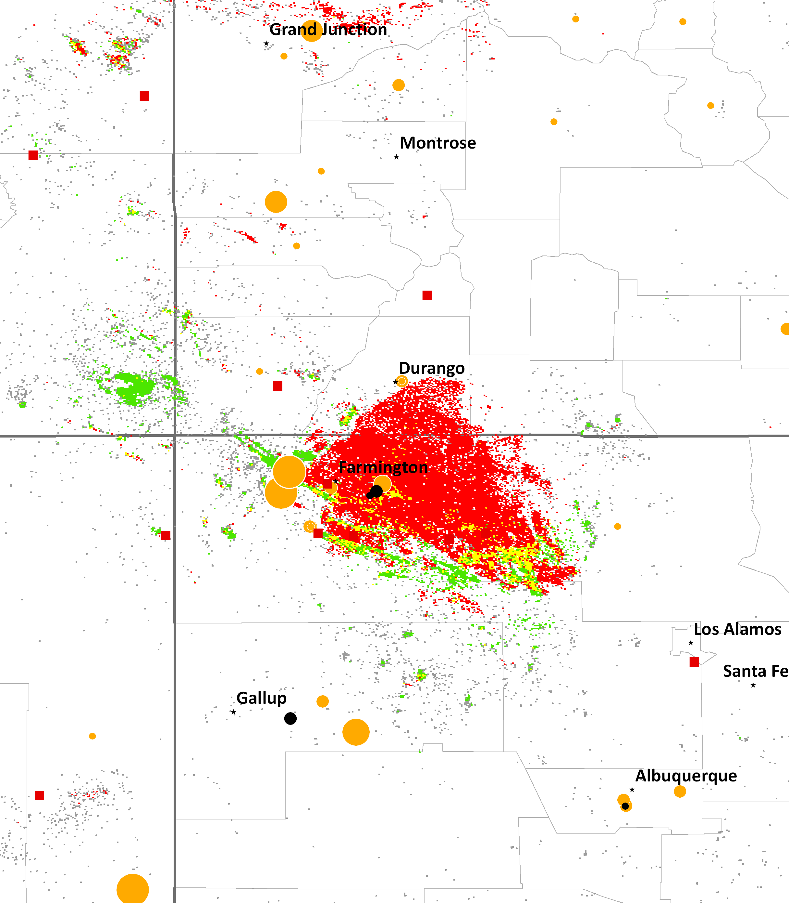
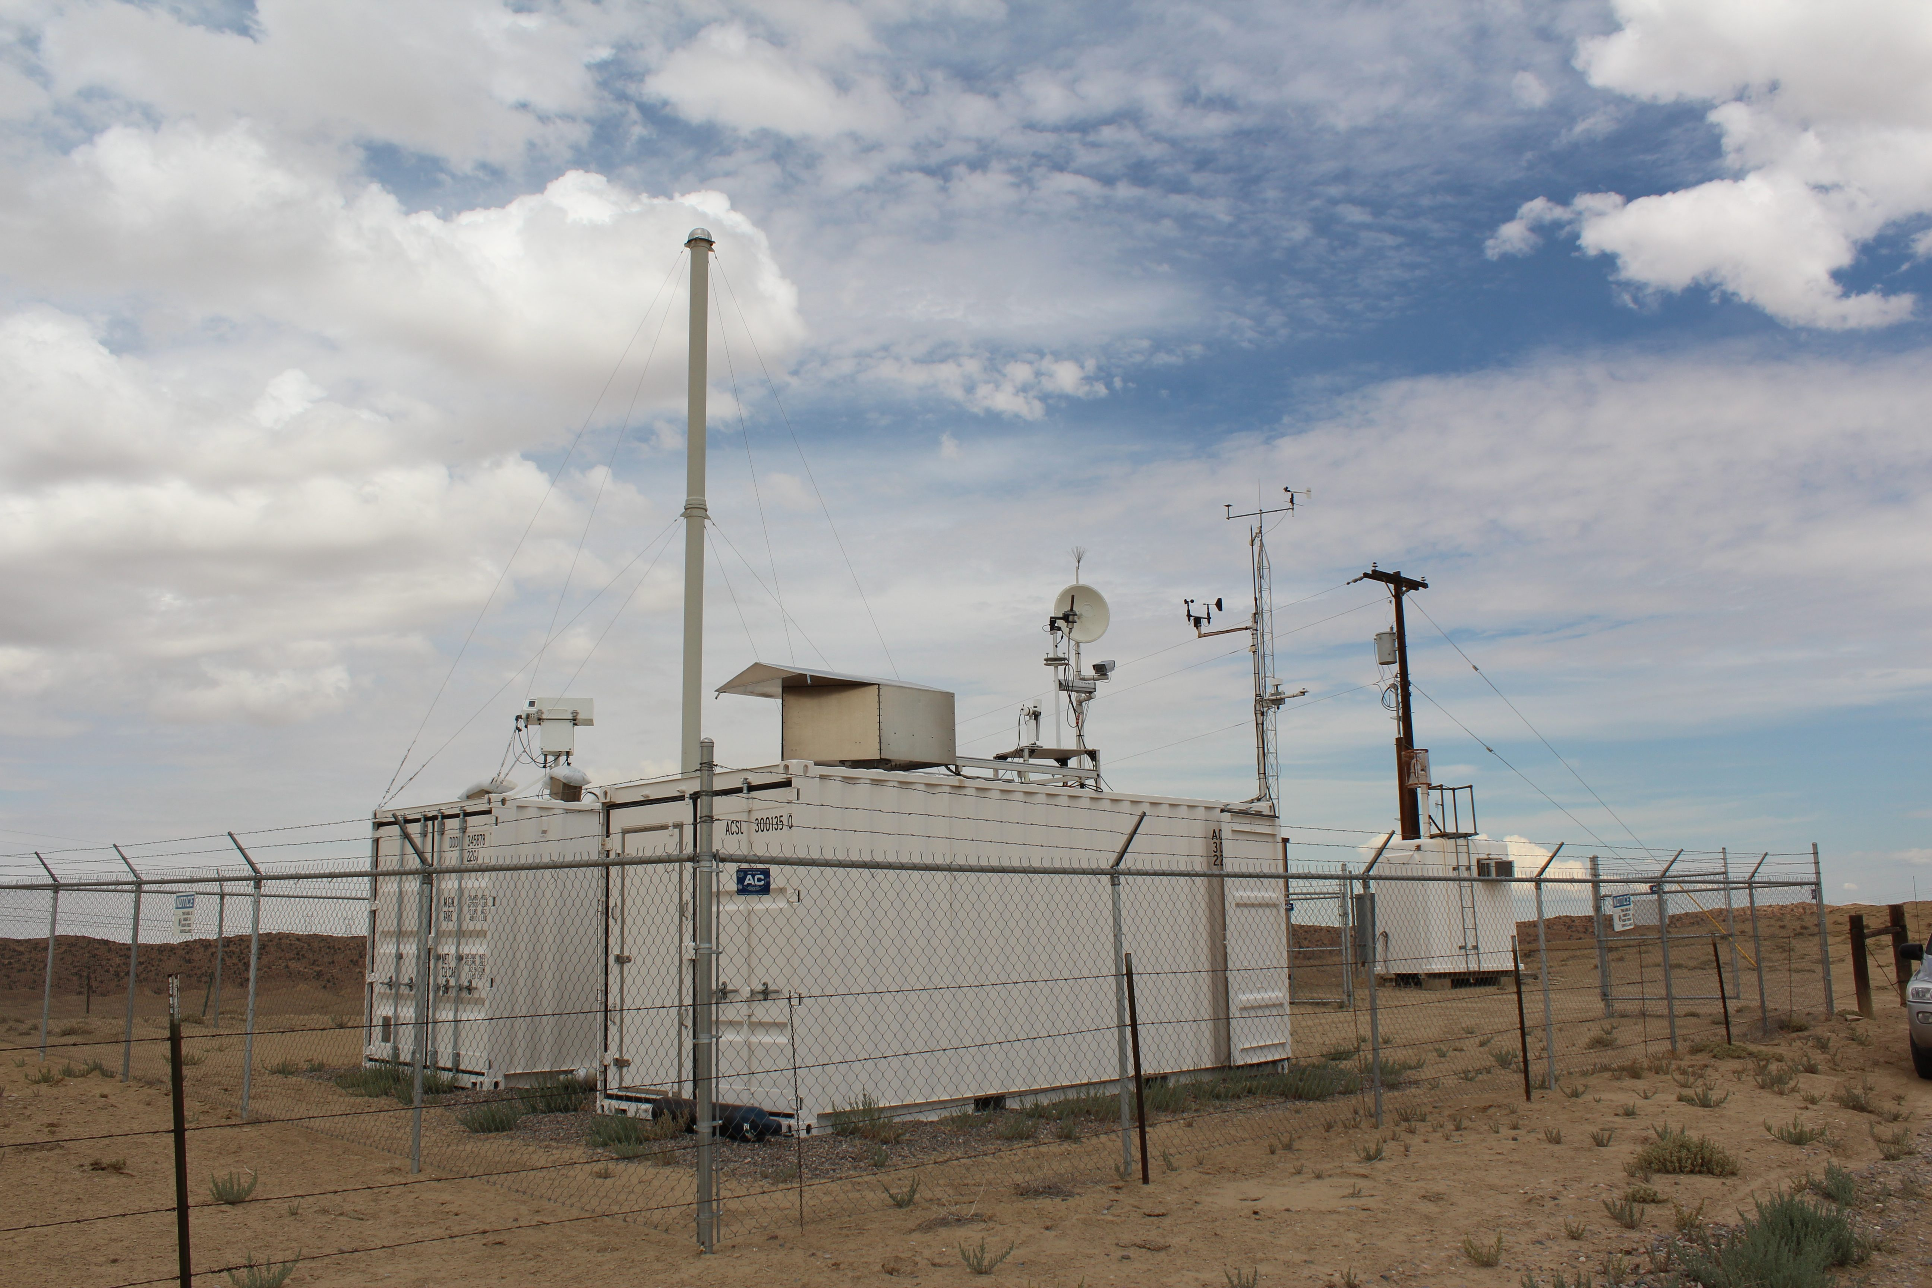
Four Corners Methane Hot Spot in Space & Time
Persistent morning CH₄ high when site is downwind of source E/SE of site (70% gays)
Four Corners
LANL Four Corners TCCON (11-13)
Kort et al. GRL 2014

Slide 5
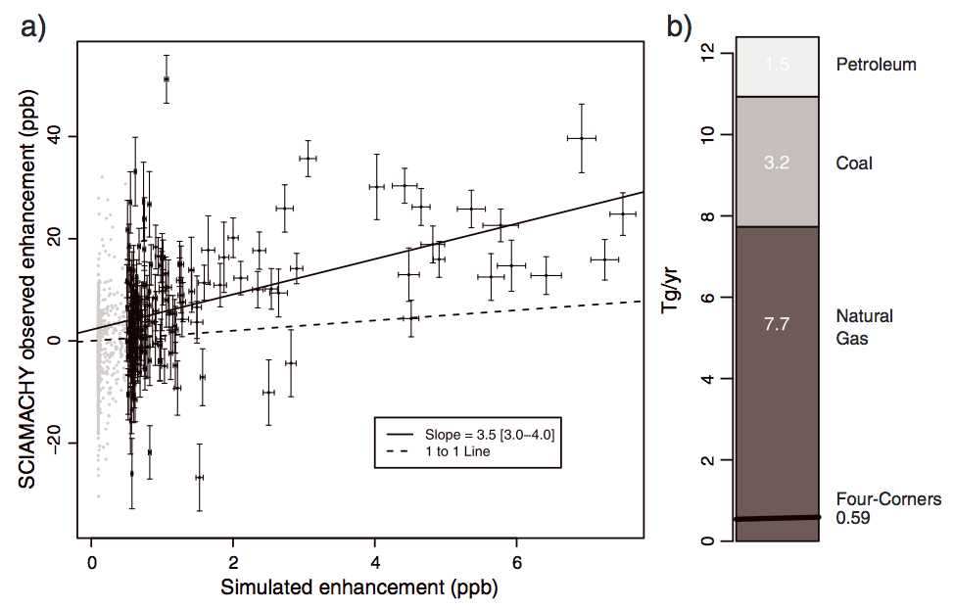
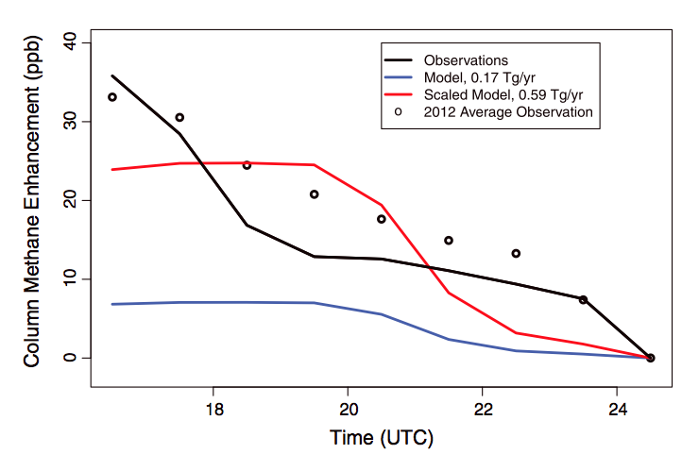
Simulations (WRF) with CH₄ inventories ( Edgar) are a factor of 3.5 lower than observations
SCIAMACHY (03-09)
TCCON (2011-2012)
Emissions from Four Corners of ~0.59 Tg CH₄/yr have persisted 2003-2009, 2012. This is 10% of US EPA estimates of emissions from natural gas.
Source not related to recent shale boom with high-volume hydraulic fracturing and horizontal drilling , but likely established fossil fuel extraction activities
Kort et al. GRL 2014

Slide 6
Evaluate Compact Commercial Low Resolution Solar FTS with Inbuilt Camtracker against TCCON to fill gaps
TCCON Bruker 125HR, Res: 0.014 cm⁻¹ InGaAs Det. 3800-12000 cm⁻¹ External tracker 20 foot seatainer ~500Kg Cost ~ $600K Stationary
TCCON
Tracker
Tracker
TCCON
125HR
EM27
EM27
EM27/SUN, Pendulum Res: 0.5 cm⁻¹ InGaAs Det. 6000-9000 cm⁻¹ Inbuilt Camtracker 470 x 630 x 350 cm Mass: ~25 kg Cost ~ $100K Mobile
Use TCCON as a standard for EM27/SUN
Reduce, size, cost, operational ease

Slide 7
Four Corners (Power plant) Daily Variations
EM27 tracks
125HR
EM27 is high by
20 ppb
CO₂
CH₄

Slide 8
Four Corners Daily Variation (Cont.)
CO₂
CH₄
*
Tight correlations demonstrate EM27 tracks 125HR changes in CO₂ & CH₄
EM27 CH₄ is high by 20ppb

Slide 9
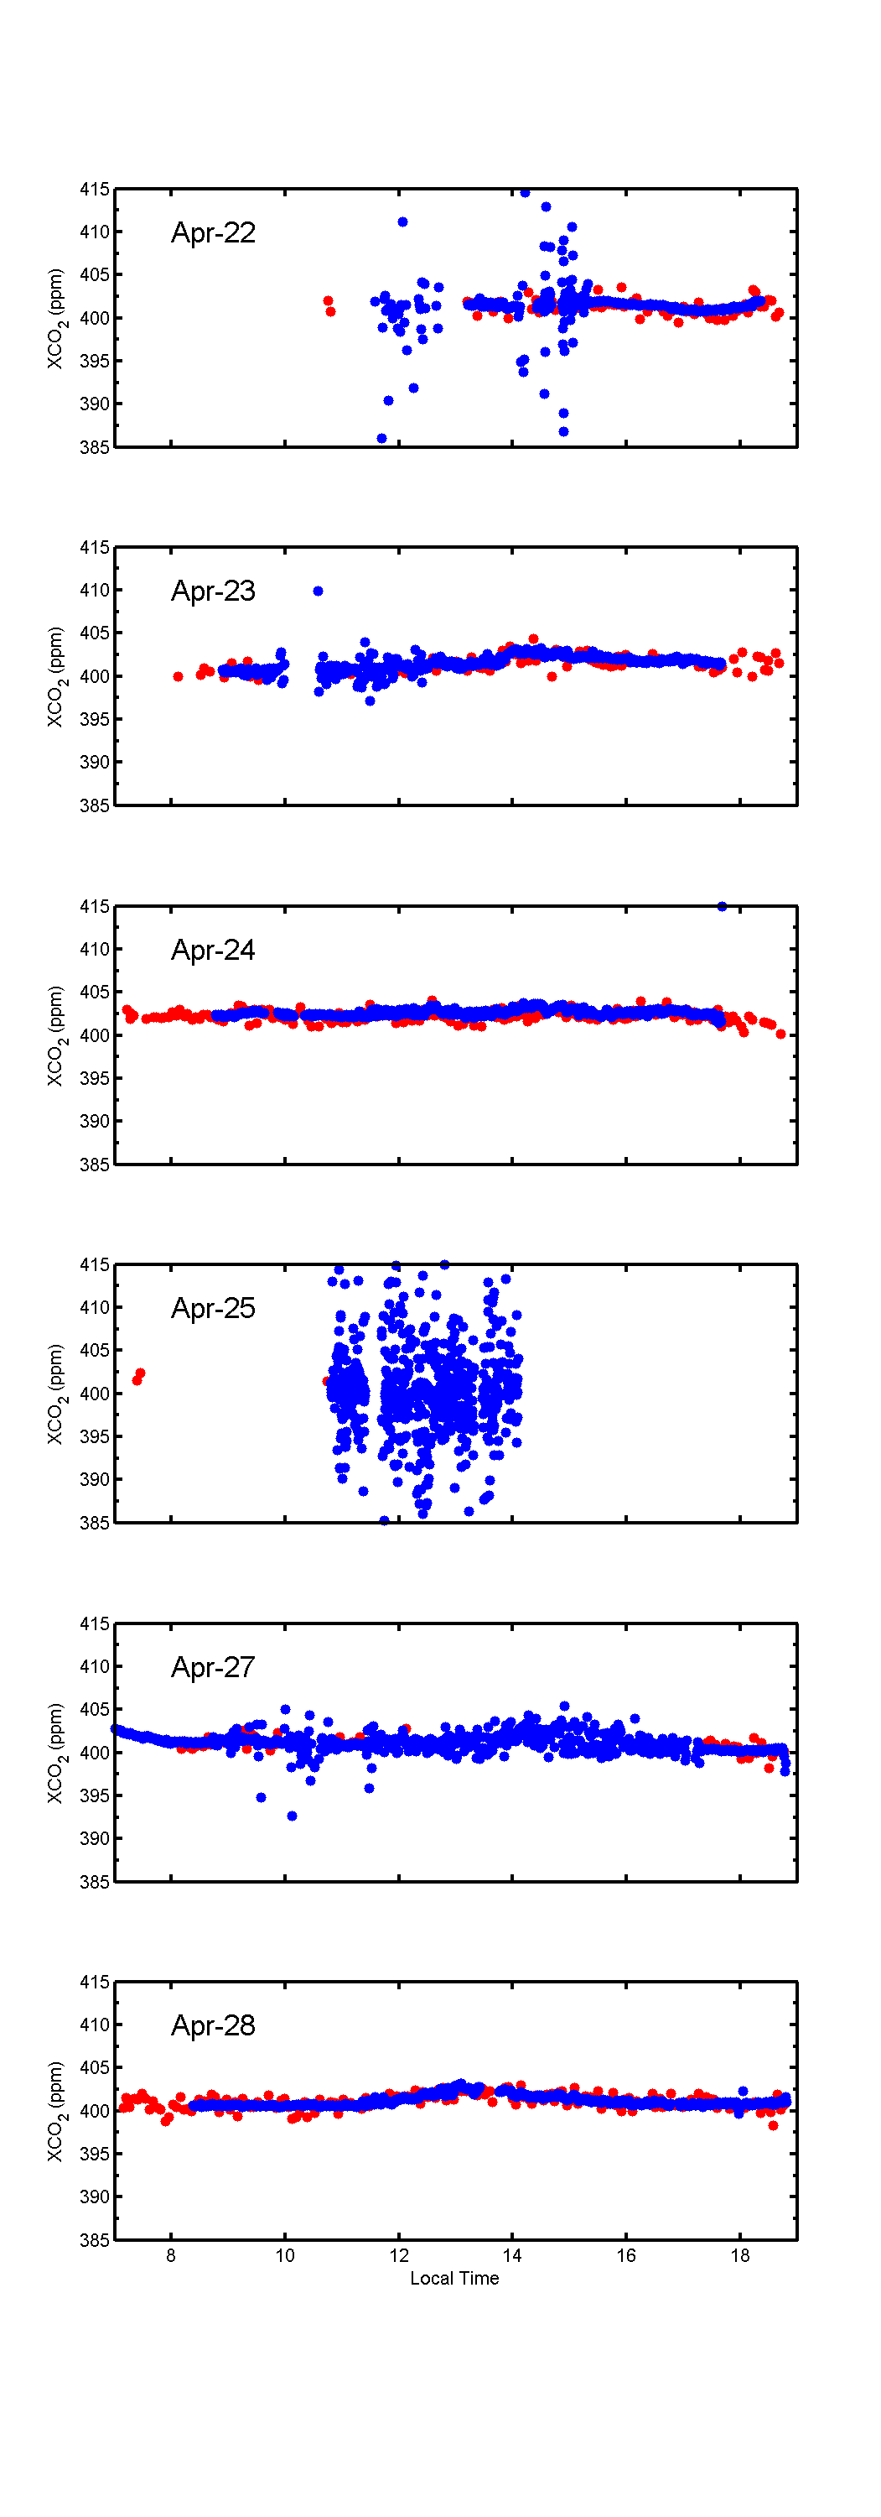
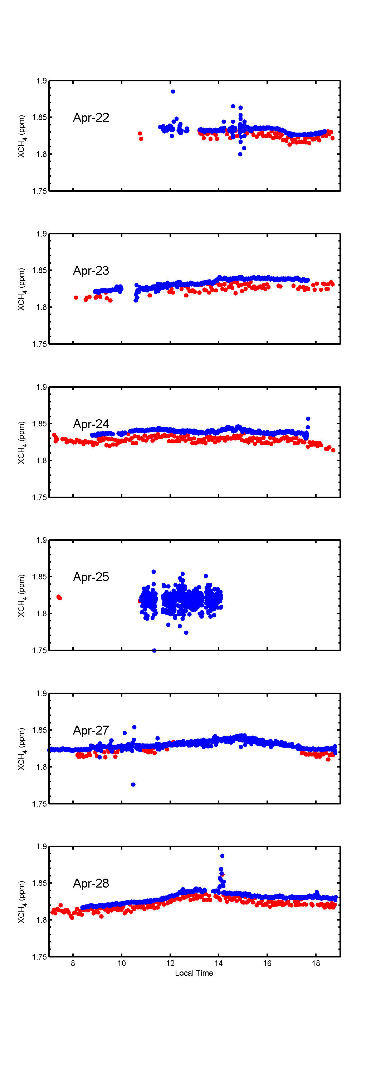
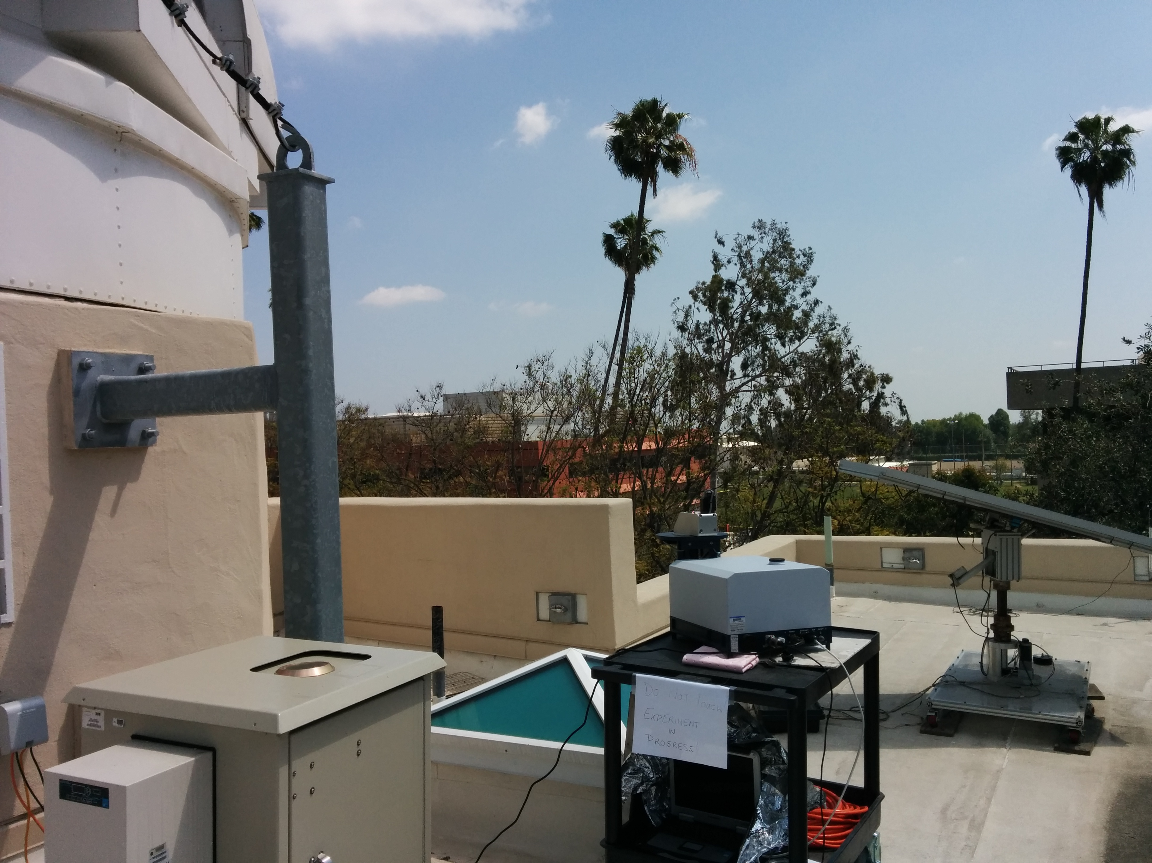
Caltech Daily Variation (Urban)
CO₂
CH₄
EM27 tracks 125HR changes in
CO₂ and CH₄ very well
EM27 CH₄ is higher that 125HR by 20 ppb

Slide 10
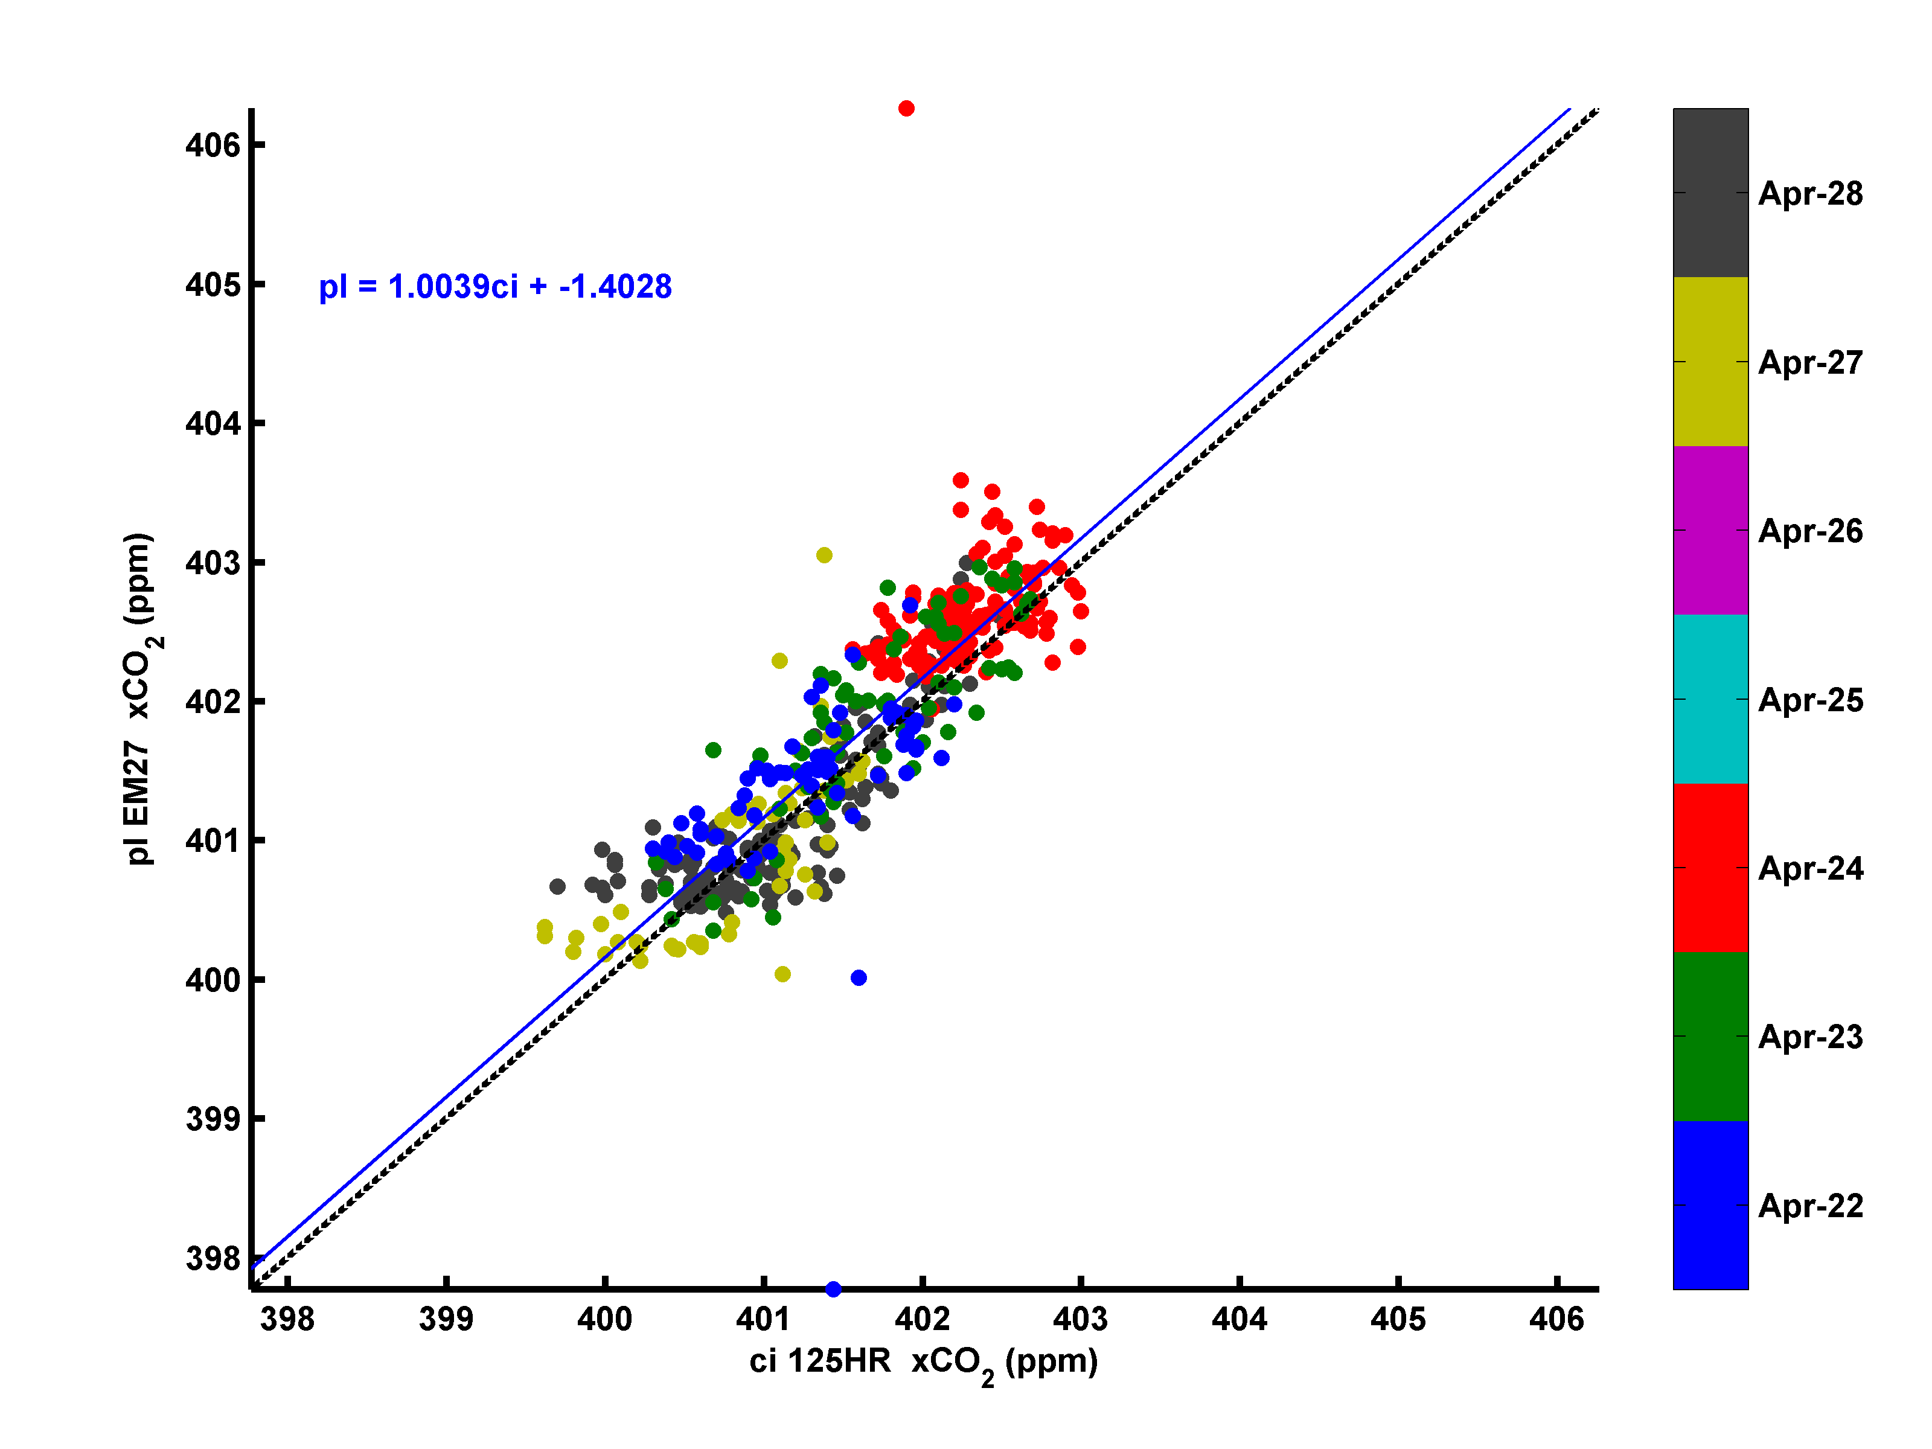
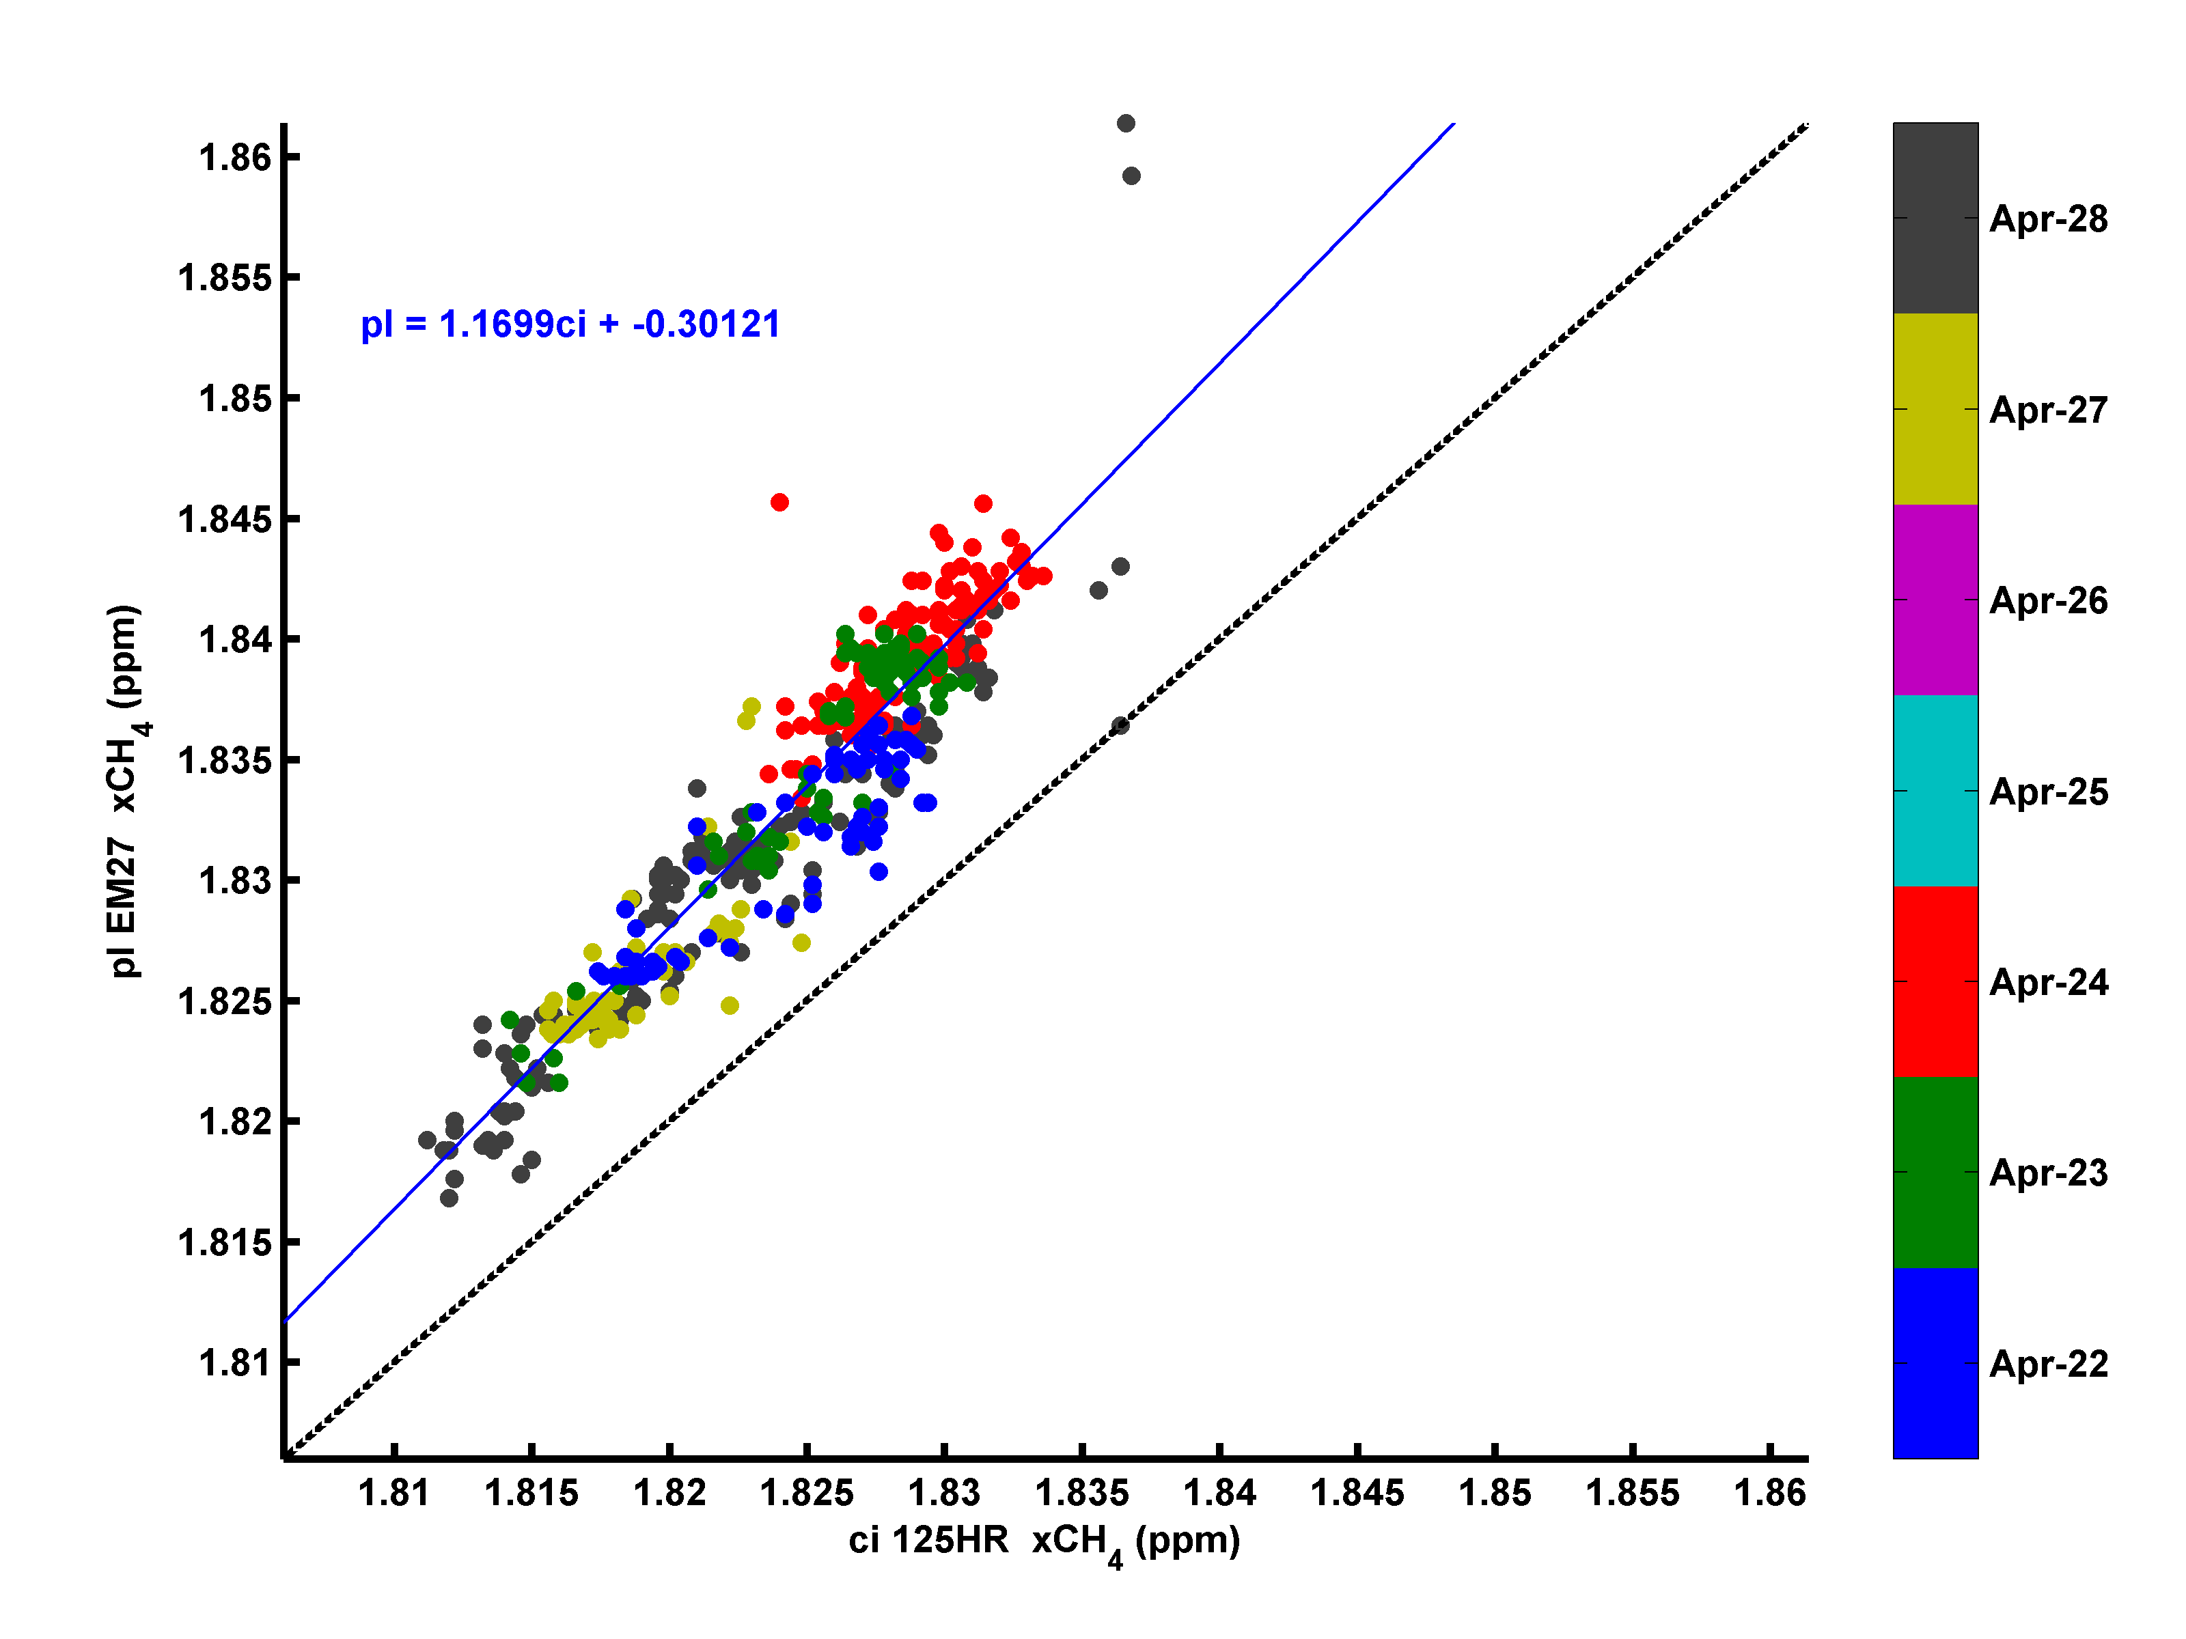
Caltech Diurnal (Urban)
CH₄
CO₂
*
Tight correlations demonstrate EM27 tracks 125HR changes in CO₂ and CH₄
EM27 CH₄ is high by 20ppb

Slide 11
Los Alamos Diurnal Profile (Remote)
EM27 tracks 125HR
CO₂ and CH₄ well including slow variations.
Not enough variation to compare changes

Slide 12
Conclusions and Future Work
Atmospheric remote sensing verification of CH₄ fugitive leaks
Demonstrated EM27 tracks daily CO₂ and CH₄ changes measured by the 125HR in power plant, urban and remote well.
The EM27 is biased high by 20 ppb relative to 125HR.
The EM27 that was shipped from Germany and has been driven extensively over a year is remarkably stable.
2015: TCCON campaigns in OK, WI & possibly Eureka.
2016: Propose deployment to Brazil and Philippines
Longer: ILS monitoring and calibration protocols are being developed at KIT to establish a EM27 network (COCCON) with KIT (4), LANL (1), Caltech (1), Harvard (2) instruments.

Slide 13
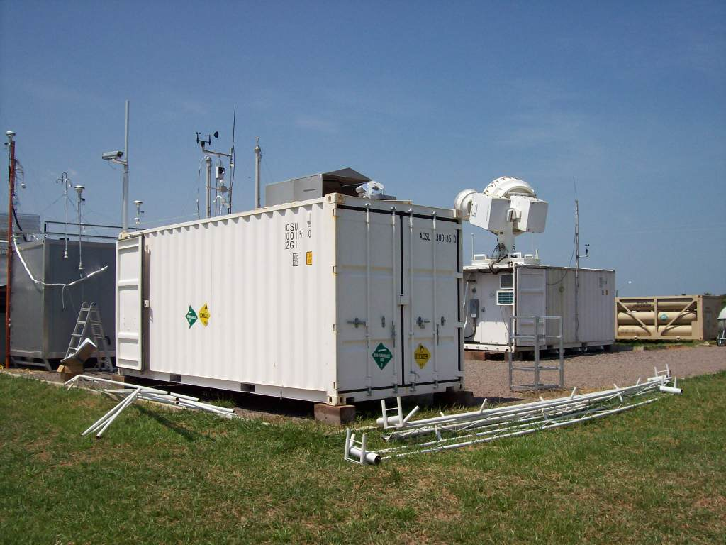
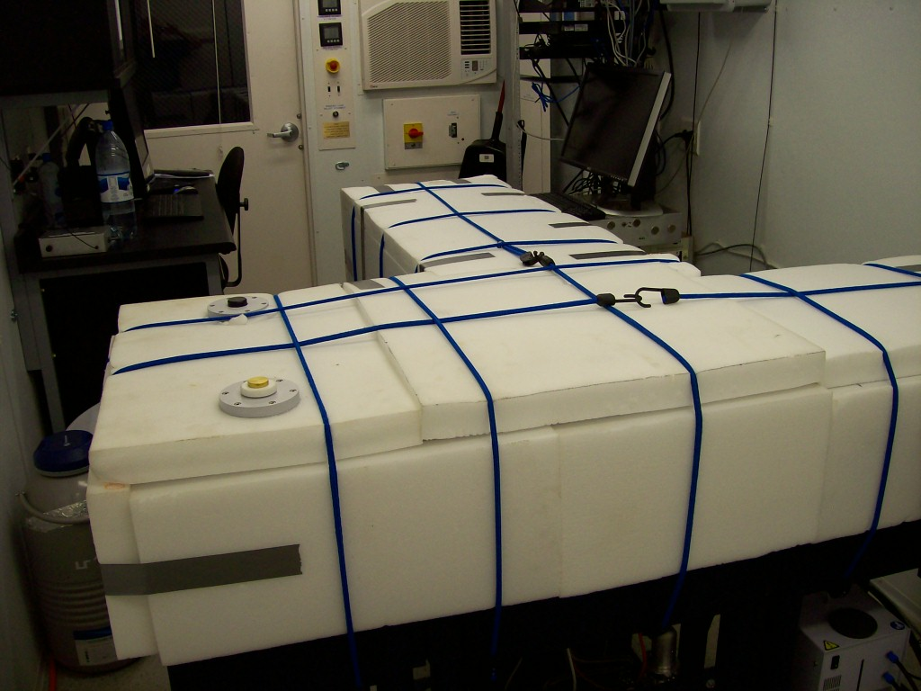
Regional Atm. Carbon-Water Coupling Observations in Amazon Rainforest to Evaluate CLM (Dubey, TES)
FTS monitors Regional Column CO₂, CO, CH₄, N₂O, H₂O/ HOD every minute
2 In situ Picarros monitoring CO₂, CO, CH₄ & HOD/H₂O
FTS can monitor OCS & H₂CO
Successful Install - Automated Operations Started 9/30/14
OCO-2 Validation – Target site programmed by NASA
Integrated with scaling CLM tasks for NGEE-Tropics
http://campaign.arm.gov/goamazon2014/documents/AmzonSolarFTS-Science-abstract.pdf

Slide 14
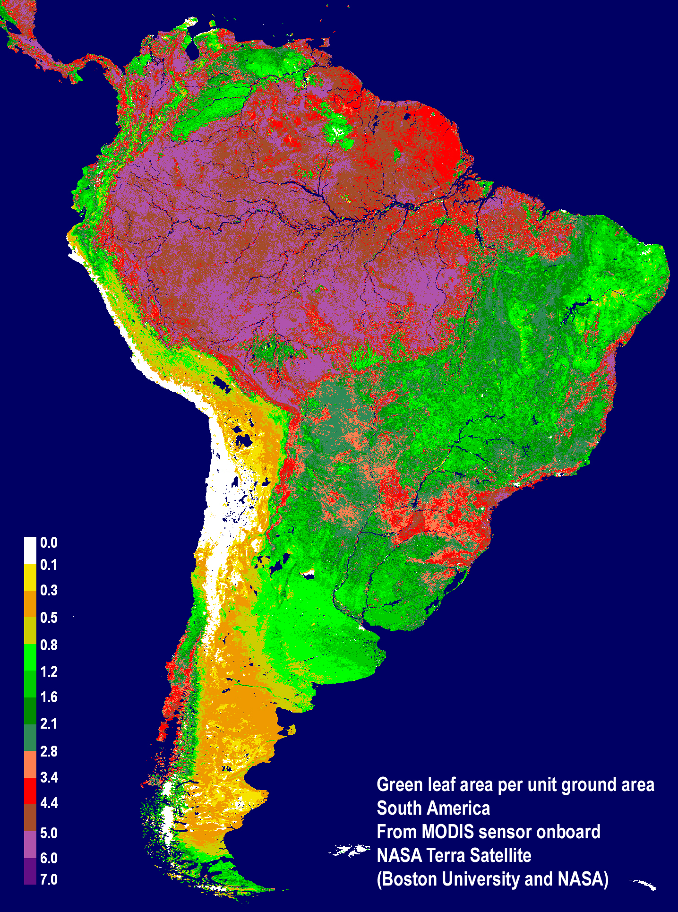
Target
Gases
CO₂, CH₄, CO, N₂O
H₂O,
HOD(ET)
OCS (Photosynth)
H₂CO(BVOC)
Manaus
TCCON
125HR
InSb (NIR)
InGaAs (MIR)
Si (vis)
Picarro
CO, CO₂, CH₄,
H₂O, HOD
Paramaribo
Manaus
Porto Velho
Volta Redonda

Slide 15
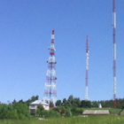
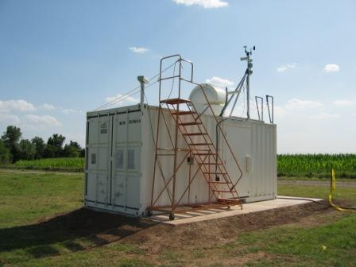
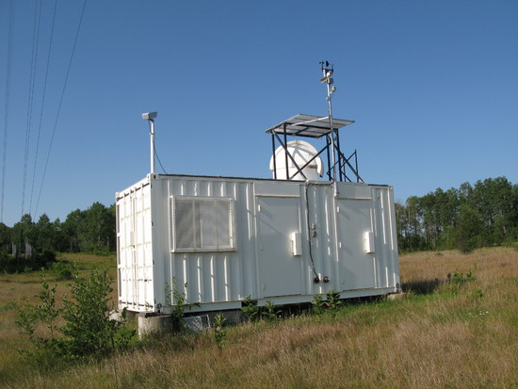
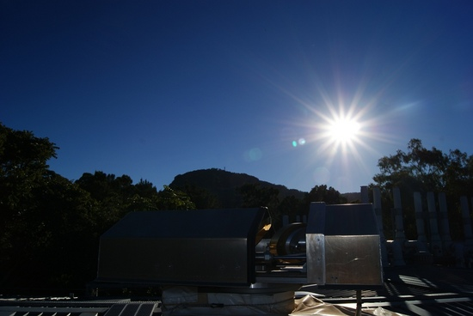
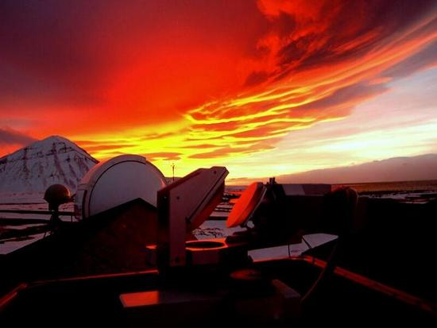
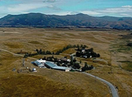
TCCON Instruments
  Ground-based Solar Fourier transform spectrometers
  Remote sensing of total columns of CO₂, CH₄, N₂O, CO, H₂O, HDO, O₂ via solar absorption
  Divide trace gas columns by O₂ column to get dry-air mole fractions: XCO₂, XCH₄, XN₂O, XCO, XH₂O, XHDO
Molecule | Precision | Accuracy
CO₂ | ~0.8 ppm | ~0.8 ppm
CH₄ | ~5 ppb | ~7 ppb
N₂O | ~1.5 ppb | ~3 ppb
CO | ~0.5 ppb | ~4 ppb

Slide 16
Portable mini-mobile FTS tested at 4-Corners, Los Alamos & Los Angeles
Need for portable and robust instrument Without compromising
Accuracy and long term
Stability! EM27/SUN
Pendulum FTIR
Resolution: 0.5 cm⁻¹
470 x 630 x 350 cm
~25 kg incl. tracker

Slide 17
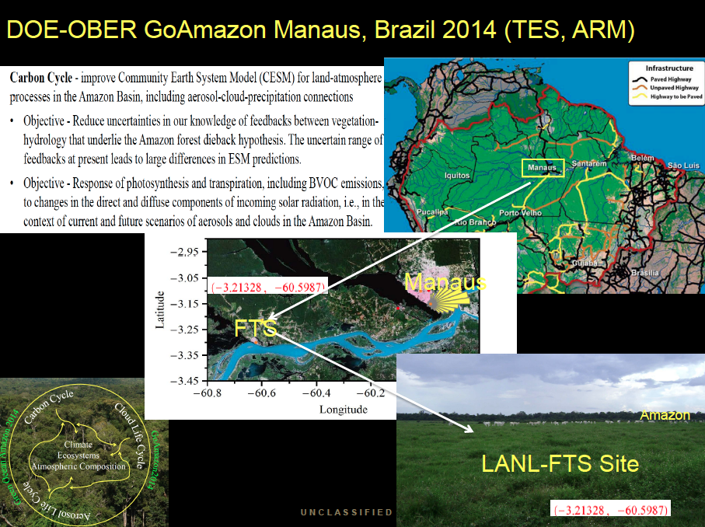

Slide 18
TCCON confined to developed nations
Gaps in developing regions

